Slide 1
Case study on SOA
CASE-STUDY SOA DESIGN AND DEVELOPMENT FOR BEPET
By
Dharani Priya T

Slide 2
What is SOA?
Service-oriented architecture (SOA) is a method of software development that uses software components called services to create business applications.
Each service provides a business capability, and services can also communicate with each other across platforms and languages.
Developers use SOA to reuse services in different systems or combine several independent services to perform complex tasks

Slide 3
Key principles of SOA
Standardized service contract
Loose coupling
Abstraction
Reusability
Autonomy
Statelessness
Discoverability
Composability

Slide 4
Introduction to case study
The Bepet which is an Energy company want to sign an agreement with IT department which can make Bepet services better for the customer and IT Company tries to fulfill all the requirements of Bepet.
SOA is an IT control policy follows in institution. The main concept of SOA is to provide services on SOA Governance from beginning to the end.
The main concept of SOA is to provide services on SOA Governance from beginning to the end approach. The lifecycle of services are development, deployment and retirement of service framed by the process, policies, procedures, roles, and responsibilities for design-time governance and runtime governance.

Slide 5
BEPET service components
Home-based Saving Energy
Saving Energy Guidelines
Energy efficient Product
Gas Boiler
Repairing Boiler Service

Slide 6
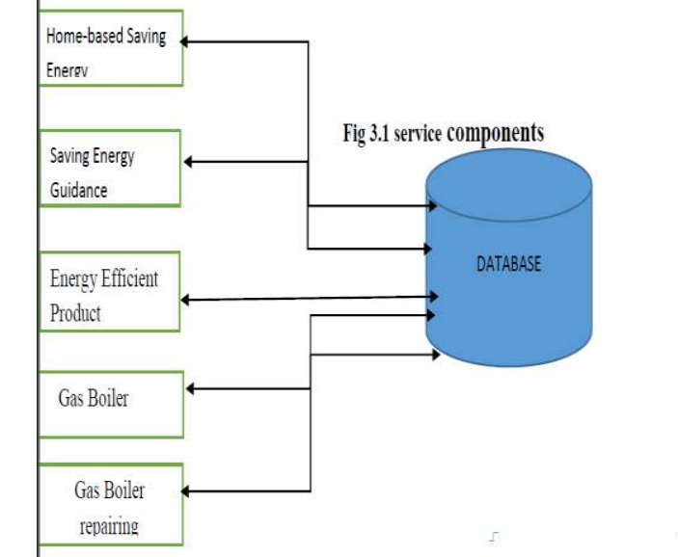
BEPET service components

Slide 7
List of services (B2B and B2C business types) for Bepet services
Business Implementation Services using Bepet SOA:
Service oriented architecture is not only used between the customer and a small level company also it is implemented for business to business service where one company handles some part of data of the company. To make better service of the Bepet energy company, IT administration setup an environment which is the association between applications, platforms, business process and data sources which will play important roles in Bepet to make better services.
Bepet Service Oriented Architecture Service
There are three categories of the of the Bepet business application services, defining a service as self-contained and independent unit of work.
Human decision services
Information Services
Functional Service

Slide 8
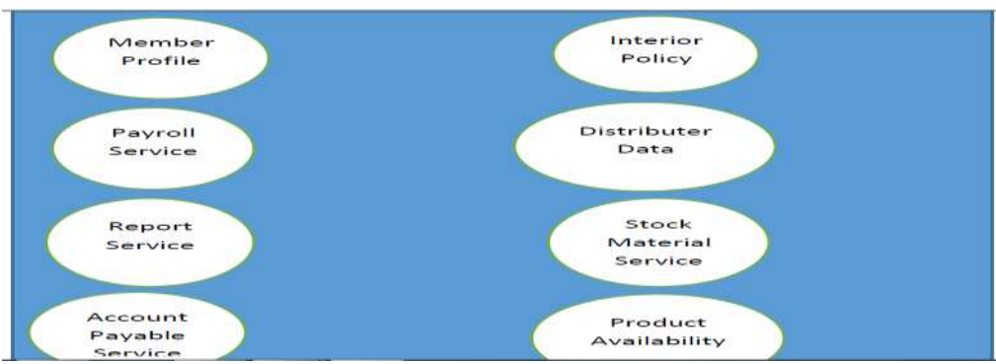
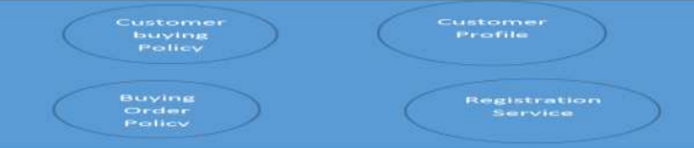
.
B2B Service
B2C Service

Slide 9
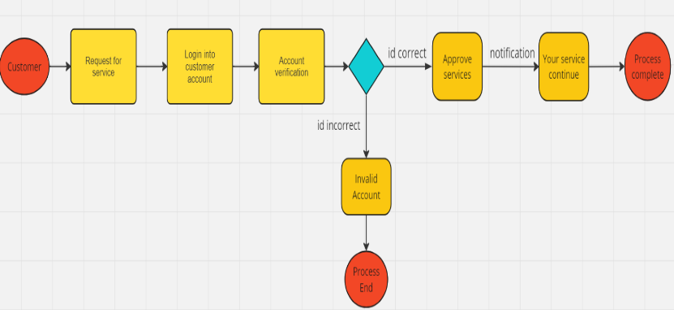
UML diagram

Slide 10
Result and discussion
Bepet application for organization:
Services that fall into its grouping which organize the smaller square organizations to illuminate basic business fundamentals.
Services form a group which runs into the organizations or administration for the development of the business. These kinds of management flexible and change according to the needs and ready to help to the other organization.
The main objective of the IT Company is to implement the services quickly in low cost which can be possible using methodology.

Slide 11
Continue…
Service operations:
Service on the internet:
All the web services come under internet service which can be accessed from anywhere and it is location independent. It is only for those organizations which want to provide some company service to another company or a customer. The data security is the most important of this online web service and those have appropriate permission only they access these service. For example, email id verification is more feasible in the internet in comparison to intranet situation. This type of situation includes business-to-business (B2B) or customers workplace organizations.
The Intranet services:
Combination of services:
Service Input:
Service output
Service Exception

Slide 12
Conclusion
The overall discussion is based on providing services to the organization and research also set an example of the Bpet which show that how can implement the services and what characteristics should be.

